Slide 1
First BootCamp Project
Understanding the performance of financial assets
Enrique Gavira / January 6

Slide 2
What is the objective of the presentation?
Understanding the performance of assets under different economic scenarios
Scenarios
Growth : Gross Domestic Product
Inflation: Consumer Index Price
Assets:
Stocks : S&P 500
Bonds: US Gov Bonds 10 years
Cash: US Gov Bonds 13 weeks
Gold: Gold COMEX

Slide 3
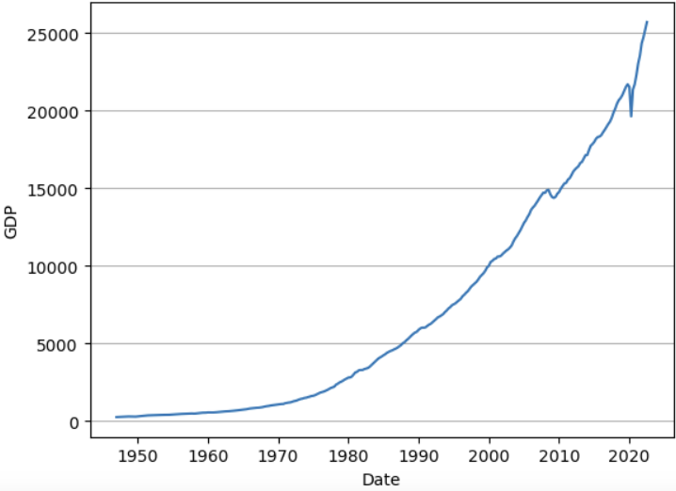
Growth: Gross Domestic Product (GDP)
5% Average Growth
Only 2 recessions
Notes:
Comment here: -looking into the future -- can say oh hey burger king your goal was 150 million? With 95% accuracy, i can see that you are going to be $50 mm short of that if you keep things the same now.
Points here
-basic output: blue box. Doing this with really high accuracy.
-segments, top 20%
-really high accuracy- about 90% accurate or higher.
-looking into the future - help with customer goal, use movies anywhere as an example

Slide 4
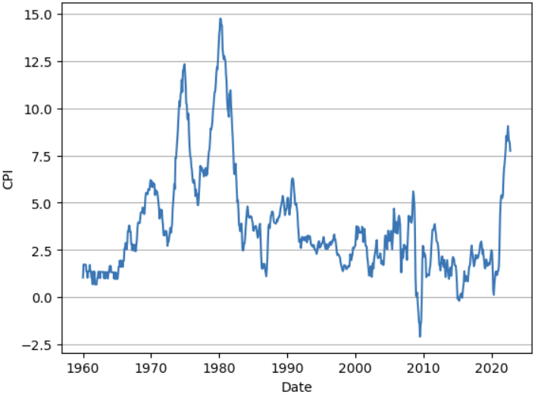
Inflation: Consumer Price Index (CPI)
70´s: Bretton Woods
80´s: Oil Glut
2022: Post Covid
- 2009: Financial Crisis
Notes:
I'm calling out that you can use LTV to figure out the chance of churn. This will leave you room to segway into reegnagement
Point here: alot of ppeople think that LTV is just an acquisition play, but its also a retention play

Slide 5
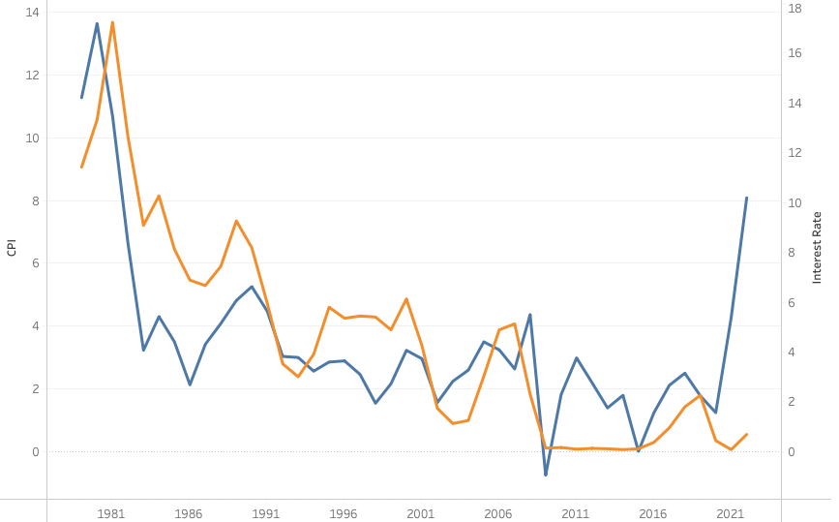
Inflation and Interest Rates: A close relation
Notes:
Maybe also, only focusing on the top 20% of customers.

Slide 6
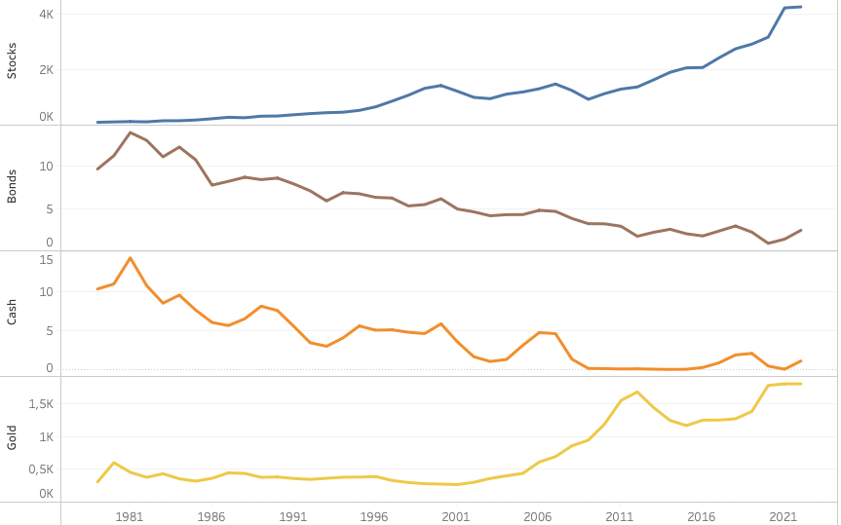
Assets: General View
Notes:
will comment here: how many of you know if an app or a web user is more valuable to your client? Now you know.

Slide 7
Analysis: Correlation between assets and scenarios
 | GROWTH | INFLATION
STOCKS | 0,94 | -0,26
BONDS | -0,89 | 0,61
CASH | -0,81 | 0,69
GOLD | 0,85 | -0,19
 | GROWTH | INFLATION
RISING | Stocks | IL Bonds
FALLING | Bonds Gold | Stocks Bonds
Notes:
Movies anywhere is the example here
call out here is that we could also look at just app users, in addition to just looking at top 20% of customers.
Can see which types of movies bring in your best customers

Slide 8
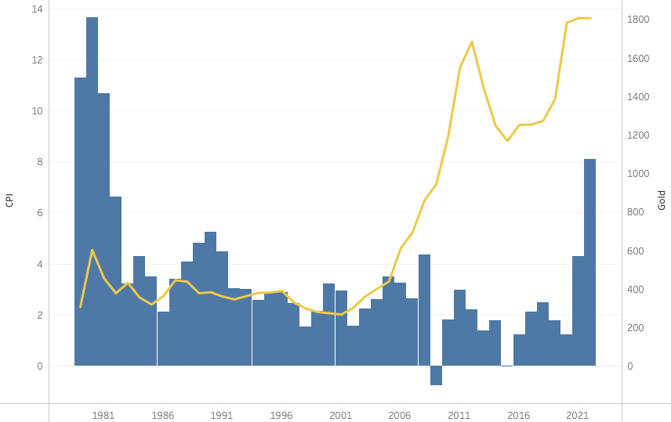
Analysis: Gold as a particular case
Correlation
between CPI and Gold?
Correlation
Between Gold and
Uncertainty?
Notes:
Chance of churn= 1-p-alve
P-alive is their chance of coming back
the call out here is that LTV can predict the chance of someone churning. Therefore we know who to retarget
Chance of churn

Slide 9
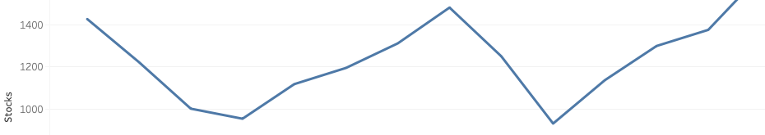
Lost Decade: Trying to avoid the disaster
What happened in the lost decade?
DATE | DATE | LOSS | DATE TO RECOVER
01/08/2000 | 01/02/2003 | 44,58 % | 01/05/2007
01/10/2007 | 01/02/2009 | 52,56 % | 01/03/2013
Notes:
Movies anywhere is the example here
call out here is that we could also look at just app users, in addition to just looking at top 20% of customers.
Can see which types of movies bring in your best customers

Slide 10
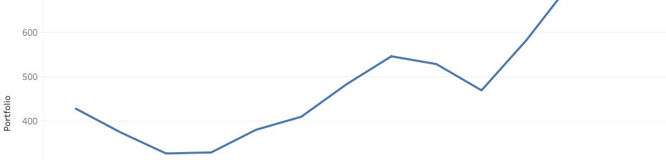
Lost Decade: Trying to avoid the disaster
Let's try diversifying in the 4 assets studied
Portfolio = 0,25 * Stocks + 0,25 * Bonds + 0,25 * Cash + 0,25 * Gold
DATE | DATE | LOSS | DATE TO RECOVER
01/08/2000 | 01/02/2003 | 33.93% | 01/01/2006
01/10/2007 | 01/02/2009 | 27.98%% | 01/04/2010
Notes:
Movies anywhere is the example here
call out here is that we could also look at just app users, in addition to just looking at top 20% of customers.
Can see which types of movies bring in your best customers

Slide 11
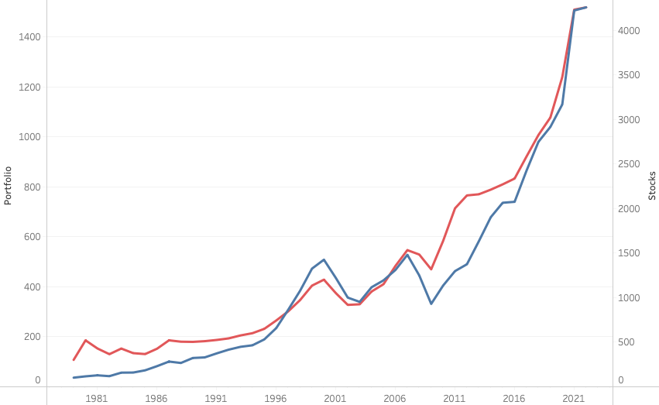
Lost Decade: Trying to avoid the disaster
Notes:
Now let’s look at most often purchased

